Slide 1
March 27, 2014
MATH 323
Graph Theory
Cr. 3
Lecture 1
Prof. Dr. Bhadra Man Tuladhar

Slide 2
Graph Theory
Fundamental Concepts
Trees
Planar Graphs
Graph Coloring
Matching

Slide 3
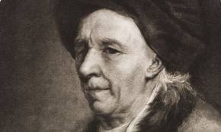
Leonhard Paul Euler
(1707 – 1783)
Born on April 15, 1707, in Basel, Switzerland, Leonhard Euler was one of math's most pioneering thinkers, establishing a career as an academy scholar and contributing greatly to the fields of geometry, trigonometry and calculus, among many others. He released hundreds of articles and publications during his lifetime, and continued to publish after losing his sight. He died on September 18, 1783.

Slide 4
Graphs
In mathematics and computer science, graph theory is the study of graphs, which are mathematical structures used to model pairwise relations between objects.
Graph theory has proven useful in the design of integrated circuits for computers and other electronic devices.

Slide 5
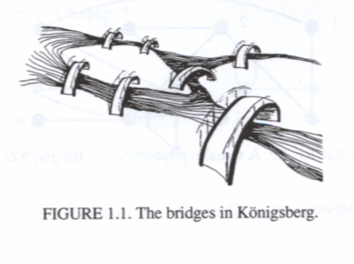

Fundamental Concepts
Examples:
Königsberg Bridge
(1700)
To walk across a route that crossed each of these bridges exactly once.
In 1736 Leonhard Euler gave a negative proof.

Slide 6

Examples (Contd.)
Four Color Map
(1852 – DeMorgan)
Four is the maximum number of colors required to color any map where bordering regions are colored differently.
In 1976 Appel and Haken proved the conjecture positively.

Slide 7
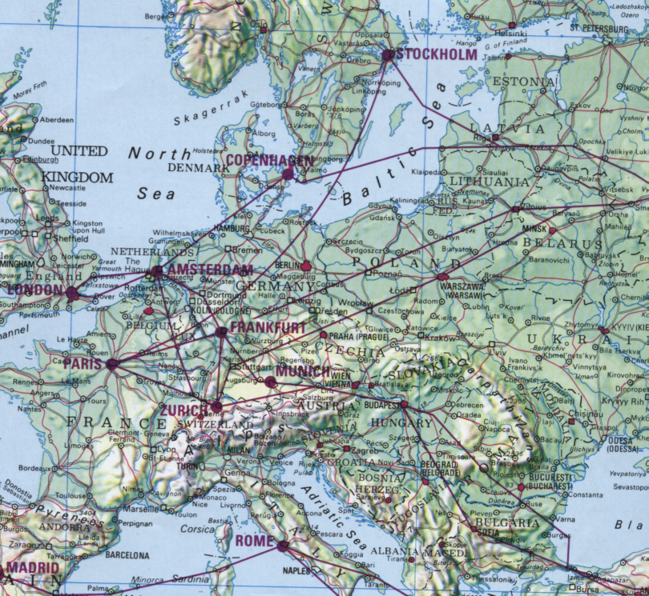
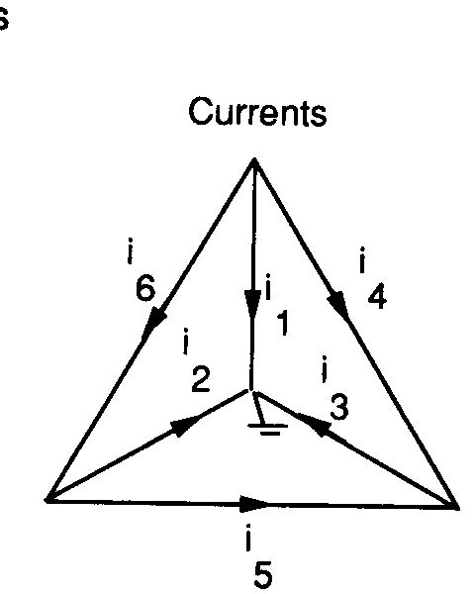

More Examples
Air Route
Electrical Circuit

Slide 8
Examples (Contd.)
Interior angles of a polygon
Polygon No. of sides ΣInterior angles
Triangle 3 π
Rectangle 4 2 π
Pentagon 5 3 π
Hexagon 6 4 π
n-sided n
(n-2) π

Slide 9
Examples (Contd.)
Euler Formula
Figure Vertex Edge Face
(V) (E) (F)
3-pyramid 4 6 4
4-pyramid 5 8 5
Cube 8 12 6
V + F = E + 2
Relation:

Slide 10
Some Definitions
Graph – A graph G(V,E) with n vertices and m edges consists of
a vertex set V(G) = (v₁, v₂, …, v_{n}) and
an edge set E(G) = (e₁, e₂, …, e_{m}), where each edge consists of two (possibly equal) vertices called endpoints.

Slide 11
Visual Representation
1
3
2
4
5
6
8
7
Vertex set, V = {1, 2, 3, 4, 5, 6, 7, 8}
Edge set, E = {{1,4}, {1,5}, {2,3},{2,5},
{2,7}, {3,6}, {4,6}, {4,7}, {7,8}}

Slide 12
Types of Graphs
By replacing set E with a set of ordered pairs of vertices, we obtain a directed graph, or digraph.

Slide 13
Types of Graph
If we allow repeated elements in the edge set, we obtain multigraph.

Slide 14
Types of Graph
By allowing edges to connect a vertex to itself (loops), we obtain a pseudograph.

Slide 15
Types of Graph
Allowing the edges to be arbitrary subsets of vertices gives hypergraphs.
A hypergraph with 6 vertices and 5 edges

Slide 16
Types of Graph
By allowing V or E to be infinite set, we obtain infinite graphs.

Slide 17
Some Notations & Definitions
An edge is denoted {u, v} or simply as uv.
The order of a graph G is the cardinality of its vertex set V.
The size of a graph G is the cardinality of its edge set E.
Given two vertices u and v, if uv∈E, then u and v are said to be adjacent. If uv∉E, u and v are nonadjacent.
If an edge e has a vertex v as an endpoint, then u and e are incident.
The neighborhoods of a vertex v, denoted by N(v), is the set of vertices adjacent to v: N(v) = {x ∈V | vx ∈E}

Slide 18
More definitions
The degree of v, denoted by deg(v), is the number of edges incident with v. In simple graphs, this is the same as the cardinality of the neighborhood of v.
The maximum degree of a graph G, denoted by Δ(G), is defined to be
Δ(G) = max{deg(v) | v ∈ V(G)}
The minimum degree of a graph G, denoted by δ(G), is defined to be
δ(G) = min{deg(v) | v ∈ V(G)}

Slide 19
Example
1
3
2
4
5
6
8
7
Vertices 1 and 5 are adjacent, vertices 1 and 2 are nonadjacent.
deg(3) = 2, deg(7) = 3, N(4) = {1, 6, 7}, Δ(G) = 3, δ(G) = 1.

Slide 20
First Theorem of GT
Theorem 1.
In a graph G, the sum of the degrees of the vertices is equal to twice the number of edges.
Alternatively, the number of vertices with odd degree is even.

Slide 21
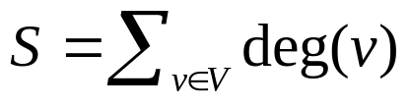
Proof
Let .
Notice that in counting S, we count each edge exactly twice.
Thus S = 2|E| (the sum of the degrees is twice the number of edges).
Since S is even, it must be that the number of vertices with odd degree is even.
(Also known as Handshaking Lemma.
If several people shake hands, then the number of hands shaken is even)

Slide 22
Special Graphs
A graph G is trivial, if it has only one vertex, otherwise G is nontrivial.
A graph is Complete, if every two vertices are adjacent. The complete graph of order n with n vertices is denoted by K_{n}.
K₃
K₄
K₄

Slide 23
Special Graphs
A graph G is said to be regular , if every vertex has the same degree. If this degree is equal to r, then G is r-regular.
Note:
A complete graph K_{n} is (N-1)-regular.
2-regular
3-regular

Slide 24
Special Graphs
The complement (clique) of G, denoted by G, is the graph whose vertex set is the same as G’s and whose edge set consists of all the edges that are not present in G.
The complement of the complete graph is called discrete Graph.

Slide 25

Special Graphs
A graph H is a subgraph of graph G, denoted by H ⊆ G, if V(H) ⊆ V(G) and E(H) ⊆ E(G).
G
subgraph
subgraph

Slide 26
Special Graphs
If H is a subgraph of G and
V(H) = V(G), then H is said to be the spanning subgraph of G.
Spanning subgraph
G

Slide 27
Special Graphs
A subgraph H of graph G is an induced subgraph , if E(H) = E(G) ∩ E(V(H)).
G
Induced subgraph

Slide 28


NEXT
Graph (contd.)
Trees

